Slide 1



Ethics for Title Agents and Attorneys
Michael Holden I Summer 2026
www.amtrustfinancial.com

Slide 2


Michael Holden, Vice President, Midwest Agency
AmTrust Title Insurance Company
C: 440-725-8973
E: Michael.Holden@amtrustgroup.com
Michael Holden
Vice President

Slide 3




About AmTrust
AmTrust provides insurance protection, warranty programs and risk management expertise to small businesses, professional and financial services firms, retailers, and manufacturers worldwide.
With hundreds of thousands of customers and employees working worldwide, our “can do” attitude propels us forward, giving us the momentum to thrive. We strive to be the best and most profitable commercial insurer for small businesses in North America, the best warranty insurer in North America, and a high-return international specialty insurer in our core products.
AmTrust is a global provider in the commercial P&C market and the third largest Workers’ Compensation provider in the U.S. Our small business product suite continues to expand with Cyber, BOP, Employment Practices Liability Insurance (EPLI), Package and other core coverages and capabilities, including more middle-market and large accounts.
AmTrust provides insurance protection, warranty programs and risk management expertise to small businesses, professional and financial services firms, retailers, and manufacturers worldwide.

Slide 4
Disclaimer
This information is not a substitute for legal advice. It is for your reference only and is not intended to represent the only approach to any particular issue.
This information should not be construed as legal, financial or business advice, and users should consult legal counsel and subject-matter experts to be sure that the policies adopted and implemented meet the requirements unique to your company.

Slide 5

Overview
The study of ethics in general
Different viewpoints about ethics
Rise of business ethics as a part of ethical philosophy
Code of Professional Conduct
What determines ethical behavior
Discipline examples
Establishing an ethical organization

Slide 6
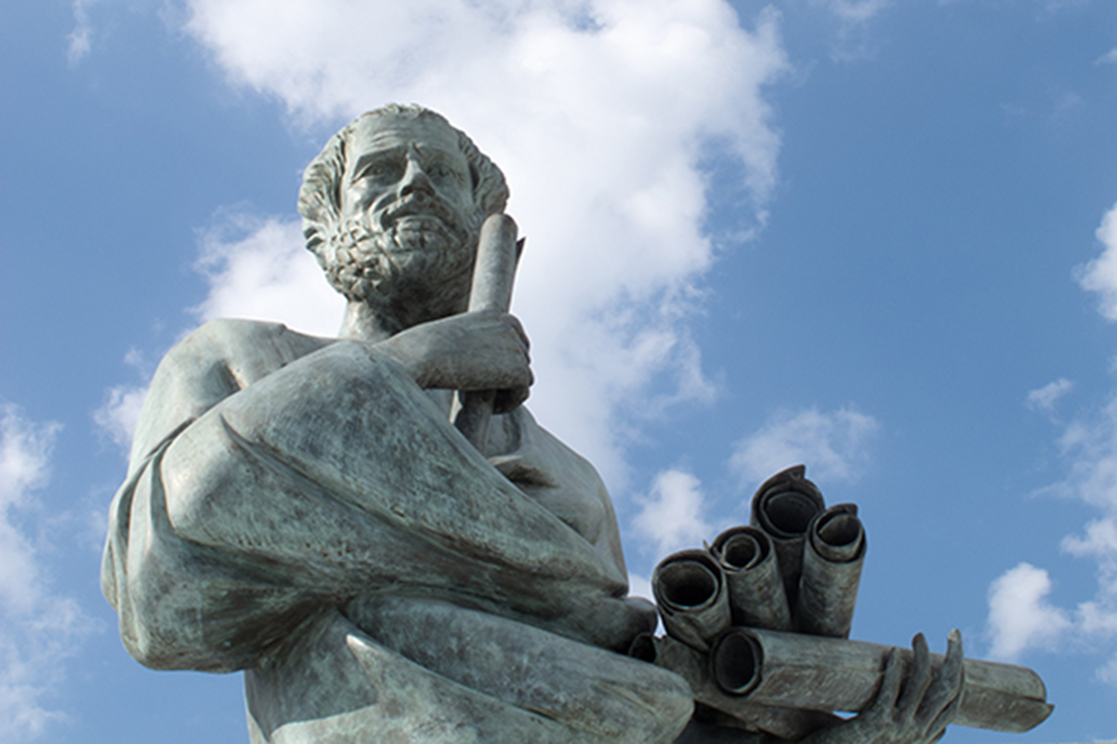
What Are Ethics?
The study of ethics dates back to Socrates or Aristotle in the 4th Century BCE
Sometimes called “Moral Philosophy”
The examination of beliefs about right and wrong – is an action right or wrong absent of context?

Slide 7
Ethical Theories
Immanuel Kant – Categorical Imperative
Utilitarianism
Machiavelli: “Ends justify the means”
Milton Friedman: “Maximize corporate profits”

Slide 8


Business Ethics
Do businesses have a moral duty to act in a certain way? (e.g., provide jobs to the unemployed or safe products)
Freidman’s “maximize profit” theory
Corporate Social Responsibility theory (CSR)

Slide 9

Unethical Behavior Happens Somewhere Else
Tendency to think of ethical failure as always occurring in organizations other than our own
Spectacular examples of ethical failure – Enron, Space Shuttle, Katrina, BP Gulf Oil Spill

Slide 10
Ethics Is About More than Financial Propriety
Spectacular and public examples of ethical failure usually focus on financial impropriety
Financial impropriety is usually indicative of more basic breakdown in basic relationships within an organization and between the organization and the wider community
Enron, and other such cases, are extreme examples of more common and everyday ethical failures at the level of relationships

Slide 11

Unethical Behavior
Unethical behavior is probably more common, more mundane and much closer to home

Slide 12
Ethics Are Rooted in Values
Beliefs about right and wrong
Yardsticks for ethical behavior that draw on feeling and thinking
Sentiment and reason lead to action

Slide 13
Business Ethics Come from Values
Do unto others as you would have done to you” =
“Treat customers as you would want to be treated”
“Think about the consequences before you act” =
“Examine the effect on employees, customers and society before acting”
“Don’t do anything you wouldn’t be proud to tell your mother” =
“Don’t do anything you would not want to see on the front page of the paper”

Slide 14

Examples of Values
Honesty
Fidelity
Courage
Charity

Slide 15
Ethical Business Principles
Maximize profit, but follow “rules of the game” (Friedman’s approach)
First do no harm (Hippocrates)
Do what you would want others to do to you (Care-based or Golden Rule Approach)

Slide 16
How do good people make bad choices?

Slide 17

The Sources of Unethical Practice
Structural determinants – Often most directly related to systems of communication and consultation, transparency and accountability
Cultural determinants – Aspects of organizational style and rhetoric
Behavioral determinants – Aspects of individual character, conduct and commitment

Slide 18
Rules of Professional Conduct
Most easily modified, although change must be managed
Typically modification of structure is the first ‘port of call’ in organizational change
Structural change achieves little in the absence of cultural and behavioral change

Slide 19
Rules of Professional Conduct
PREAMBLE: A LAWYER’S RESPONSIBILITIES
(1) A lawyer shall always pursue the truth.
(2) A lawyer, as a member of the legal profession, is a representative of clients, an officer of the legal system and a public citizen having special responsibility for the quality of justice.
(3) As a representative of clients, a lawyer performs various functions. In performance of any functions a lawyer shall behave consistently with the requirements of honest dealings with others. As advisor, a lawyer endeavors to provide a client with an informed understanding of the client’s legal rights and obligations and explains their practical implications. As advocate, a lawyer asserts the client’s position under the rules of the adversary system. As negotiator, a lawyer seeks a result advantageous to the client but consistent with requirements under these Rules of honest dealings with others. As an evaluator, a lawyer acts by examining a client’s legal affairs and reporting about them.

Slide 20
Rules of Professional Conduct
PREAMBLE: A LAWYER’S RESPONSIBILITIES
(4) In addition to these representational functions, a lawyer may serve as a third-party neutral, a nonrepresentational role helping the parties to resolve a dispute or other matter. Some of these Rules apply directly to lawyers who are or have served as third-party neutrals. See, e.g., Rules 1.12 and 2.3. In addition, there are Rules that apply to lawyers who are not active in the practice of law or to practicing lawyers even when they are acting in a nonprofessional capacity. For example, a lawyer who commits fraud in the conduct of a business is subject to discipline for engaging in conduct involving dishonesty, fraud, deceit or misrepresentation. See Rule 8.4.
(5) In all professional functions a lawyer should be competent, prompt and diligent. Competence implies an obligation to keep abreast of changes in the law and its practice, including the benefits and risks associated with relevant technology. A lawyer should maintain communication with a client concerning the representation. A lawyer should keep in confidence information relating to representation of a client except so far as disclosure is required or permitted by the Rules of Professional Conduct or other law.

Slide 21
Rules of Professional Conduct
PREAMBLE: A LAWYER’S RESPONSIBILITIES
(6) A lawyer’s conduct should conform to the requirements of the law, both in professional service to clients and in the lawyer’s business and personal affairs. A lawyer should use the law’s procedures only for legitimate purposes and not to harass or intimidate others. A lawyer should demonstrate respect for the legal system and for those who serve it, including judges, other lawyers and public officials. While it is a lawyer’s duty, when necessary, to challenge the rectitude of official action, it is also a lawyer’s duty to uphold legal process. For example, a lawyer may counsel and assist a client regarding Montana’s cannabis-related laws. In the event Montana law conflicts with federal or tribal law, the lawyer shall also advise the client regarding related federal and tribal law and policy.
(7) As a public citizen, a lawyer should seek improvement of the law, access to the legal system, the administration of justice and the quality of service rendered by the legal profession. As a member of a learned profession, a lawyer should cultivate knowledge of the law beyond its use for clients, employ that knowledge in reform of the law and work to strengthen legal education. In addition, a lawyer should further the public’s understanding of and confidence in the rule of law and the justice system because legal institutions in a constitutional democracy depend on popular participation and support to maintain their authority…

Slide 22
Rules of Professional Conduct
PREAMBLE: A LAWYER’S RESPONSIBILITIES
(8) Many of a lawyer’s professional responsibilities are prescribed in the Rules of Professional Conduct, as well as substantive and procedural law. However, a lawyer is also guided by personal conscience and the approbation of professional peers. A lawyer should strive to attain the highest level of skill, to improve the law and the legal profession and to exemplify the legal profession’s ideals of public service.
(9) A lawyer’s responsibilities as a representative of clients, an officer of the legal system and a public citizen are harmonious. A lawyer can be a dedicated advocate on behalf of a client, even an unpopular one, but in doing so must comply with these Rules of Professional Conduct. So also, a lawyer can be sure that preserving client confidences ordinarily serves the public interest because people are more likely to seek legal advice, and thereby heed their legal obligations, when they know their communications will be private.

Slide 23
Rules of Professional Conduct
PREAMBLE: A LAWYER’S RESPONSIBILITIES
(10) In the nature of law practice, however, conflicting responsibilities are encountered. Virtually all difficult ethical problems arise from conflict between a lawyer’s responsibilities to clients, to the legal system and to the lawyer’s own interest. The Rules of Professional Conduct often prescribe terms for resolving such conflicts. Within the framework of these Rules, however, many difficult issues of professional discretion can arise. Such issues must be resolved through the exercise of sensitive professional and moral judgment guided by the basic principles underlying the Rules. These principles include the lawyer’s obligation to protect and pursue a client’s legitimate interests, within the bounds of the law, while maintaining a professional, courteous and civil attitude toward all persons involved in the legal system.
(11) The legal profession is self-governing. Although other professions also have been granted powers of self-government, the legal profession is unique in this respect because of the close relationship between the profession and the processes of government and law enforcement. This connection is manifested in the fact that ultimate authority over the legal profession is vested in the courts.

Slide 24
Rules of Professional Conduct
PREAMBLE: A LAWYER’S RESPONSIBILITIES
(12) Self-regulation helps maintain the legal profession’s independence from government domination. An independent legal profession is an important force in preserving government under law, for abuse of legal authority is more readily challenged by a profession whose members are not dependent on government for the right to practice.
(13) The legal profession’s relative autonomy carries with it special responsibilities of self-government. The profession has a responsibility to assure that its regulations are conceived in the public interest and not in furtherance of parochial or self-interested concerns of the bar. Every lawyer is responsible for observance of the Rules of Professional Conduct. A lawyer should also aid in securing their observance by other lawyers. Neglect of these responsibilities compromises the independence of the profession and the public interest which it serves.
(14)… (21) See accompanying handouts

Slide 25
Rules fo Professional Conduct
RULE 5.3: RESPONSIBILITIES REGARDING NONLAWYER ASSISTANTS
With respect to a nonlawyer employed or retained by or associated with a lawyer:
(a) A partner, and a lawyer who individually or together with other lawyers possesses comparable managerial authority in a law firm, shall make reasonable eff orts to ensure that the fi rm has in effect measures giving reasonable assurance that the person’s conduct is compatible with the professional obligations of the lawyer;
(b) A lawyer having direct supervisory authority over the nonlawyer shall make reasonable efforts to ensure that the person’s conduct is compatible with the professional obligations of the lawyer; and
(c) A lawyer shall be responsible for conduct of such a person that would be a violation of the Rules of Professional Conduct if engaged in by a lawyer if:
(1) The lawyer orders or, with the knowledge of the specific conduct, ratifies or ignores the conduct involved; or
(2) The lawyer is a partner or has comparable managerial authority in the law fi rm in which the person is employed, or has direct supervisory authority over the person, and knows of the conduct at a time when its consequences can be avoided or mitigated but fails to take reasonable remedial action.

Slide 26
Cultural Determinants
Often harder to modify than structural determinants,
mainly because they are less readily identifiable and understood
Essentially tied to the style or ethos of an organization’s management and leadership
Typically determined from the top –
Largely dependent on the example set by senior management

Slide 27

Changing Organizational Culture
What are the five most important values you would like to see represented in your organizational culture?
Are these values compatible with your current organizational culture? Do they exist now? If not, why not?
If they are so important, why are you not attaining these values?

Slide 28
Behavior Determinants
Behavioral determinants are much harder to address than structural or cultural because they are based in personality and character
Behavioral determinants are often based in problematic features of character and conduct that are not recognized as such by individuals concerned
Behavioral determinants are often related to features of character and conduct that are positively selected for in many organizations – that are encouraged by the organizational culture

Slide 29
Problematic Aspects of Behavior
Failure to listen or to respond properly to concerns
Failure to open conduct to more general scrutiny
Failure to face up directly to instances of real conflict
Willingness to rely on physical presence or other forms of implicit or explicit threat to promote compliance
Willingness to use insult or public disparagement against subordinates
Willingness to exploit or sacrifice relationships to achieve one’s ends

Slide 30
Unethical Conduct of Individuals
DEADLY TRIANGLE OF UNETHICAL BEHAVIOR
  Perceived Opportunity
  Perceived Pressure
  Rationalization

Slide 31
The Corrosion of Character
American Social Theorist Richard Sennett described the way in which changes in the character of many contemporary work practices (structural and cultural) appeared to lead to a loss of trust, fragmentation in social relations, lack of social and ethical responsibility.
− The Corrosion of Character, New York: W. W. Norton, 1998)

Slide 32
Cultural Factors
  Cultural factors that encourage unethical conduct:
Emphasis on “results” – Positive evaluation given to the “tough” manager
Devaluation of deliberative processes in favor of executive decision
Emphasis on short-term perspectives in evaluation of success
Individual integrity replaced by procedural adequacy
Reliance on relations of personal “patronage”
Inability to recognize the limited and often failing character of all managerial practice

Slide 33
Breakdown of Ethics and Integrity
Ethical conduct ultimately dependent not on systems and structures, but on character, style and ethos
Unethical organizations are those that allow and promote the “corrosion of character” – Loss of individual ethical integrity and understanding
The corrosion of character occurs through the dissociation of individuals (and organizations) from a wider social context

Slide 34
How to build an ethical organization

Slide 35
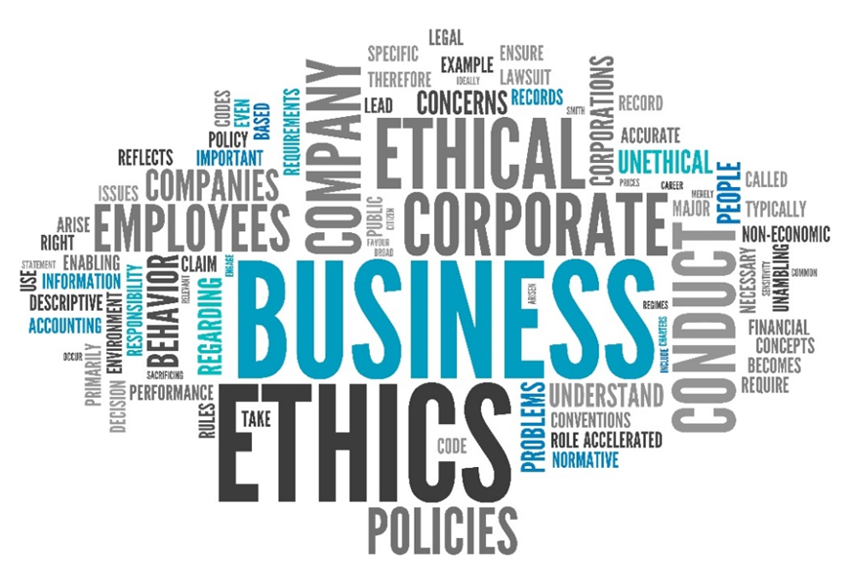
How to Build an Ethical Organization
Building ethical organizations is a matter of building personal character and integrity
Building character is a matter of establishing the right organizational ethos and style
Organizational structure can support ethos and integrity, but cannot create it

Slide 36

How to Build an Ethical Organization
Create a structure that supports ethics: code of conduct, ethical training, resources
Promote ethical behavior from the top of the organization
Choose associates on the basis of ethics and how they would contribute to the ethics of the organization

Slide 37
DISCIPLINARY COUNSEL v. MILLER

Slide 38

Disciplinary Actions
$2.26 million transaction:
  Transaction required approval of a newly created legal description for the tract by the city engineer
  Deal closed without the approval, and deeds were sent to be recorded
  Funds were disbursed
  Recorder rejected conveyance documents for lack of city approval of new legal description

Slide 39
Disciplinary Actions
$2.26 million transaction:
  Another attorney in the same firm requested the recorded documents for the purposes of the buyer applying for the transfer of a liquor license
  Mr. Miller created falsified documents with false recording information, provided them to the attorney for the buyer and left on a planned vacation
  The firm and the affiliated title company discovered the false documents, and proceeded to rectify the situation by obtaining city approval and recording the documents about a month later
  Mr. Miller’s employment was terminated, and he self-reported his conduct to the disciplinary counsel

Slide 40

Disciplinary Actions
Result:
12-month suspension:
Stayed on the condition that the respondent does not engage in further misconduct

Slide 41
Disciplinary Actions
Why?
Influenced by preplanned vacation? Pressure of time?
Perception that it was done to allow an application for liquor license to be transmitted – Planned to fix recording later?
Doubt if he expected to get caught?
What lessons do we learn about this case?

Slide 42
Mahoning County v. Lavelle

Slide 43
Disciplinary Actions
Divorce Case (Count 2 of case):
Mr. Lavelle prepared for client “Cupp” a petition for dissolution of marriage, financial disclosure forms and proposed judgment entry. Mr. Cupp never fully paid retainer to Mr. Lavelle, and case was delayed in being filed.
Several documents for the case were created, including disclosure forms, affidavits and settlement agreement. However, Mr. Lavelle’s paralegal falsified dates on documents, changed dates with
White-out and altered the signature page.
Mr. Lavelle’s brother, also a non-lawyer, notarized the documents without witnessing one of the Cupps sign the documents.

Slide 44
Disciplinary Actions
Divorce Case (count two of case):
Mr. Lavelle’s paralegal altered two dates on the petition for dissolution of marriage that was given to Ms. Cupp
Mr. Lavelle’s paralegal also forged a court filing stamp on the documents in question and sent them to a mortgage company

Slide 45
Disciplinary Actions
Reading from the case documents:
{¶ 19} With respect to Count Two, involving the Cupp matter … He failed to adequately supervise his secretary. Respondent's inattention created an office environment that allowed [his secretary] to place false information on documents and provide misleading information to a mortgage company. And [his secretary] or someone else in his office evidently forged respondent's signature and falsely notarized at least one document. “[I]t is a lawyer's duty to establish a system of office procedure that ensures delegated legal duties are completed properly.” Disciplinary Counsel v. Ball (1993), 67 Ohio St.3d 401, 404, 618 N.E.2d 159. Whatever safeguards respondent may have established to ensure that his office functioned properly and professionally were clearly inadequate.

Slide 46
Disciplinary Actions
Result:
Respondent is hereby suspended from the practice of law in Ohio for a period of 18 months, with 12 months of the suspension stayed on the condition that a monitor be appointed for respondent by the bar association and that respondent fully comply with any terms imposed by the monitor during the stayed portion of the suspension. If respondent fails to comply with the terms imposed by a monitor, the stay will be lifted and respondent will serve the entire term of actual suspension.

Slide 47
Disciplinary Actions
Why?
  Atmosphere of sloppy work
  Lack of office procedure that ensured compliance to the
  Code of Professional Conduct
  Non-lawyer supervision by lawyers
What lessons do we learn about this case?

Slide 48
Establishing an ethical organization

Slide 49

Establishing an ethical organization
Ethics Policies/Programs
Integrating Ethics into Your Organizations – Intervention Strategies

Slide 50
Ethics Programs and Policies
Basic prohibitions – Conflict of interest and abuse of office
Financial disclosure
Appearance of impropriety standard
Code of Professional Conduct
Proper supervision of non-lawyers

Slide 51
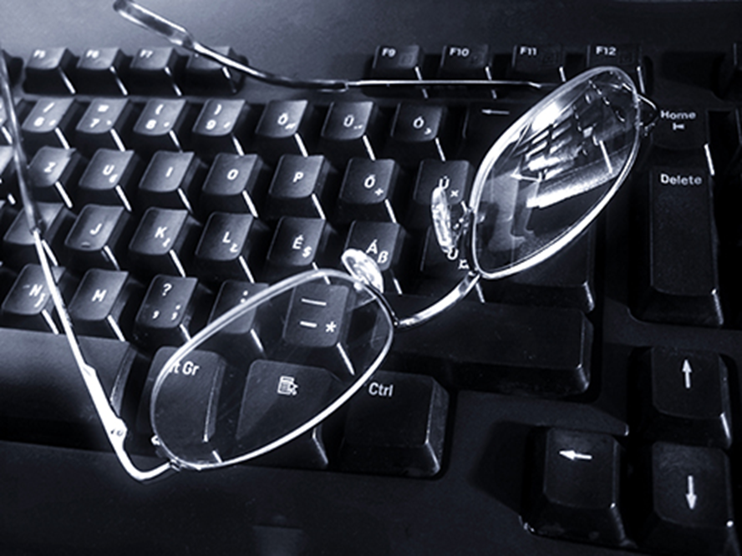
Ethics programs and policies
Supplementary restrictions –
e.g., post employment
Criminal sanctions and administrative penalties
Procedural protections for both complainant and employee

Slide 52
Ethics and the Organization
Some intervention strategies
Do both compliance and integrity training and counseling
Give briefing on common ethical problems to new hires
Designate senior manager for integrity issues
(separate from compliance/ investigative unit)

Slide 53
Ethics in the Organization
Some intervention strategies
Publicize positive, noteworthy role models
Require annual sign-off on prospective commitment and compliance
Raise ethical considerations at meetings and through regular communication channels
Train middle managers to recognize and commend employees’ statements about ethical concerns

Slide 54

Ethics in the Organization
Give serious attention to ethical treatment of subordinates, clients and others
Get the whole team – all employees, all levels, all units – to participate

Slide 55

Whistleblowing
Last resort
Not a casual choice
Appropriate only after verification of facts
Soul-searching
Administrative channels exhausted
Are you ready to accept the consequences if you are correct …
but fail to act?

Slide 56
Last Word
“Always do right. This will gratify some people, and astonish the rest.”
– Mark Twain
“Do your duty, and history will do you justice.”
– Harry S. Truman

Slide 57
Michael Holden, Vice President, Midwest Agency
AmTrust Title Insurance Company
C: 440-725-8973
E: Michael.Holden@amtrustgroup.com
Michael Holden
Vice President

Slide 58

Thank You
For additional information on AmTrust Financial or our products
and services please visit www.amtrustfinancial.com

